Slide 2
A/B Testing
Duration : 45 mins
Session by : Rukma Ramdas, Prashant Gola, Paritosh Upadhyay

Slide 3
At the end of this session:
Heuristics Evaluation & Expert Review
Learn what is A/B Testing and its uses
Learn when to use A/B Testing
Learn how to avoid common A/B Testing pitfalls
Learn which tools we can use to A/B Test
A step closer to a certified UX skill

Slide 4
Contents
Heuristics Evaluation & Expert Review
Quick interaction
Real-life use case
Netflix case study
What is A/B testing?
Why A/B testing?
Type of A/B testing
When to A/B test?
A/B testing process
Case Study 1
Possible outcomes from A/B tests
Common pitfalls to avoid
Tools & applications of A/B test
Quick recap
Case Study 2
References

Slide 5
A/B testing lies in the Testing phase of the UX journey.
A/B testing
Process graphic

Slide 6
Let’s all try this 😊
Log in to your Netflix account.
Go to “Search”.
Type “Stranger Things”.
Describe the thumbnail you see.
Note: Let’s all take 30 seconds to do this
Notes:
Before we start, let’s do a quick fun exercise^

Slide 7

Netflix and mix?
A/B Testing
SENSE8 THUMBNAILS
https://medium.com/@sdhrshn/netflix-a-b-testing-5d7c8216853f
Notes:
So, most of us have access to OTT platforms and Netflix is one of the biggest ones. More than just being a leading OTT platform, it is also a great pop culture influence.
Have you ever wondered why Netflix has such a great streaming experience? Do you want to learn how they completed their homepage plus other UI layout redesigns through A/B testing?
Which one is your favorite show? Anyone? Mine is <name of the show> due to its suspense and thriller attributes.
But have you ever noticed how Netflix sneakily shows multiple thumbnail pictures to us? This allows them to test which picture has the most click ratio.
Why does Sense8 have different imagery in different countries?
Netflix tests multiple picture thumbnails to figure out which is the most clicked variant.
Each picture has a different emotion and depending on the reach of these thumbnails, each demography would be seeing the most-tapped visual on the feeds.
With each passing day, Netflix provides all users with a more personalized and improved experience. It uses algorithms like aesthetic visual analysis to produce thumbnails a user would appreciate. Netflix also puts online machine learning to decide what to recommend based on their recent watch history.
Overall, it is an extensive and detailed process, and Netflix has mastered the art of showing us thumbnails that will lead us to stream their content instead of closing the app after browsing for a while.

Slide 8
Netflix and mix?
A/B Testing
SENSE8 THUMBNAILS
https://medium.com/@sdhrshn/netflix-a-b-testing-5d7c8216853f
Notes:
So, most of us have access to OTT platforms and Netflix is one of the biggest ones. More than just being a leading OTT platform, it is also a great pop culture influence.
Have you ever wondered why Netflix has such a great streaming experience? Do you want to learn how they completed their homepage plus other UI layout redesigns through A/B testing?
Which one is your favorite show? Anyone? Mine is <name of the show> due to its suspense and thriller attributes.
But have you ever noticed how Netflix sneakily shows multiple thumbnail pictures to us? This allows them to test which picture has the most click ratio.
Why does Sense8 have different imagery in different countries?
Netflix tests multiple picture thumbnails to figure out which is the most clicked variant.
Each picture has a different emotion and depending on the reach of these thumbnails, each demography would be seeing the most-tapped visual on the feeds.
With each passing day, Netflix provides all users with a more personalized and improved experience. It uses algorithms like aesthetic visual analysis to produce thumbnails a user would appreciate. Netflix also puts online machine learning to decide what to recommend based on their recent watch history.
Overall, it is an extensive and detailed process, and Netflix has mastered the art of showing us thumbnails that will lead us to stream their content instead of closing the app after browsing for a while.

Slide 9
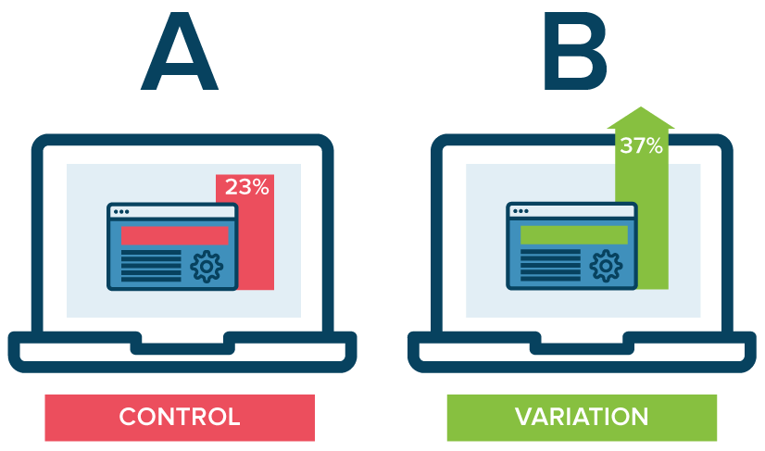
What is A/B testing in a nutshell?
A/B Testing
A/B experiment is a way to check the relative effectiveness of two or more possible solutions, to solve the same problem.
The impact of each variant is measured against each other and the current version, known as Control (A).
Experiments are generally run using target metrics and using statistical hypothesis, until there is a conclusive winner.
Finally, the most optimal solution is picked and marked as Control (default variation).

Slide 10
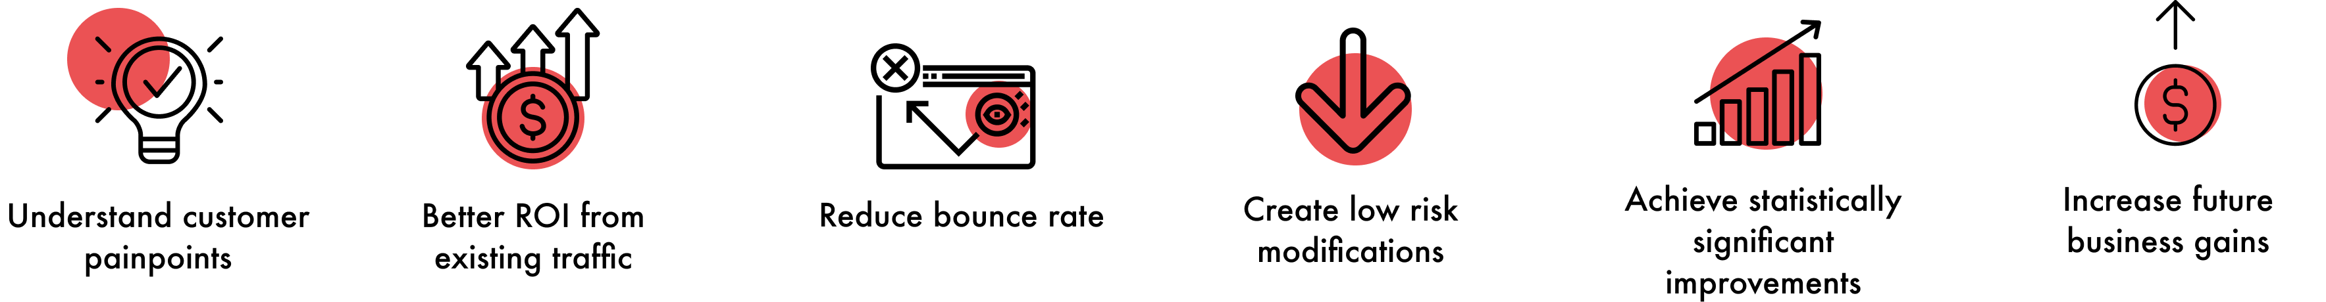
Why A/B testing?
A/B testing
https://vwo.com/ab-testing/
Notes:
Pain points : Visitors come to your website to achieve a specific goal that they have in mind. It may be to understand more about your product or service, buy a particular product, read/learn more about a specific topic, or simply browse. Whatever the visitor’s goal may be, they may face some common pain points while achieving their goal
How would we find out the pain points of the customers?
Not being able to achieve their goals leads to a bad user experience. This increases friction and eventually impacts your conversion rates. Use data gathered through visitor behavior analysis tools such as heatmaps, Google Analytics, and website surveys to solve your visitors’ pain points.
Better ROI : As most experience optimizers have come to realize, the cost of acquiring quality traffic on your website is huge. A/B testing lets you make the most out of your existing traffic and helps you increase conversions without having to spend additional dollars on acquiring new traffic. A/B testing can give you high ROI as some times, even the minutest of changes on your website can result in a significant increase in overall business conversions.
reduce bounce rate: One of the most important metrics to track to judge your website’s performance is its bounce rate. There may be many reasons behind your website’s high bounce rate, such as too many options to choose from, expectations mismatch, confusing navigation, use of too much technical jargon, and so on.
Since different websites serve different goals and cater to different segments of audiences, there is no one-size-fits-all solution to reducing bounce rate. However, running an A/B test can prove beneficial.
Create low risk : Make minor, incremental changes to your web page with A/B testing instead of getting the entire page redesigned. This can reduce the risk of jeopardizing your current conversion rate.
Significant improvements:
Since A/B testing is entirely data-driven with no room for guesswork, gut feelings, or instincts, you can quickly determine a “winner” and a “loser” based on statistically significant improvements on metrics like time spent on the page, number of demo requests, cart abandonment rate, click-through rate, and so on.
Business gains : We can talk about some examples here: Redesigning can range from a minor CTA text or color tweak on specific web pages, to completely revamping the website. The decision to implement one version or the other should always be data-driven when A/B testing. Do not quit testing with the design being finalized. As the new version goes live, test other web page elements to ensure that the most engaging version is served to the visitors.

Slide 11
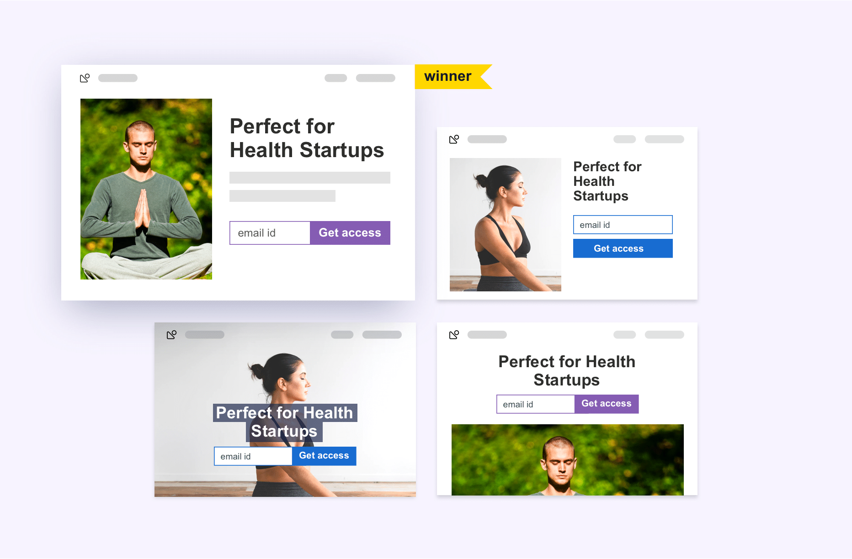
Multivariant testing
A/B testing – 3 Types
Used to analyse which combination of variables perform the best out of all possible permutations.
Use case: advanced marketing, product, and development professionals.
Helps to avoid the need to conduct sequential A/B tests.
https://vwo.com/ab-testing/#different-types-of-a-b-tests
Notes:
Multivariate testing (MVT) refers to an experimentation method wherein variations of multiple page variables are simultaneously tested to analyze which combination of variables perform the best out of all the possible permutations. It’s more complicated than a regular A/B test and is best suited for advanced marketing, product, and development professionals.
Here’s an example to give you a more comprehensive description of multivariate testing. Let’s say you decide to test 2 versions, each of the hero image, call-to-action button color, and headlines of one of your landing pages. This means a total of 8 variations are created, which will be concurrently tested to find the winning variation.
Here’s a simple formula to calculate the total number of versions in a multivariate test:
[No. of variations of element A] x [No. of variations of element B] x [No. of variations of element C]… = [Total No. of variations]
When conducted properly, multivariate testing can help eliminate the need to run multiple and sequential A/B tests on a web page with similar goals. Running concurrent tests with a greater number of variations helps you save time, money, and efforts and come to a conclusion in the shortest possible time.
Advantages of Multivariate testing
Multivariate testing typically offers primary three benefits:
Helps avoid the need to conduct several sequential A/B tests with the same goal and saves time since you can simultaneously track the performance of various tested page elements.
Easily analyze and determine the contribution of each page element to the measured gains,
Map all the interaction between all independent element variations (page headlines, banner image, etc.).

Slide 12
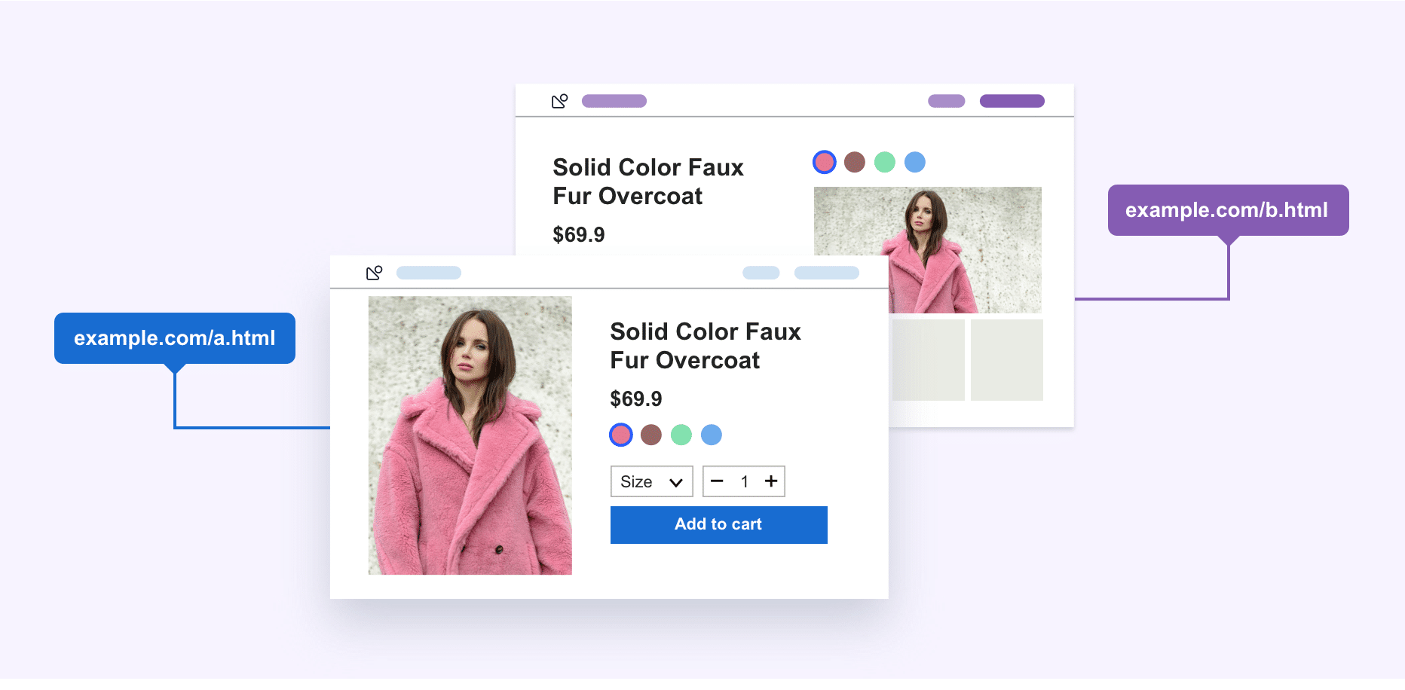
Split URL testing
A/B testing
Split URL testing is an experimentation process wherein an entirely new version of an existing web page URL is tested to analyze which one performs better.
Recommended for running tests with non-UI changes, such as switching to a different database, optimizing your page’s load time, etc.
A better and much-recommended testing method for dynamic content.
https://vwo.com/ab-testing/#different-types-of-a-b-tests
Notes:
Split URL : Many people in the testing arena confuse Split URL testing with A/B testing. However, the two are fundamentally very different. Split URL testing refers to an experimentation process wherein an entirely new version of an existing web page URL is tested to analyze which one performs better.
Advantages of Split URL testing
Ideal for trying out radical new designs while using the existing page design for comparative analysis.
Recommended for running tests with non-UI changes, such as switching to a different database, optimizing your page’s load time, etc.
Change up web page workflows. Workflows dramatically affect business conversions, helping test new paths before implementing changes and determine if any of the sticking points were missed.
A better and much-recommended testing method for dynamic content.

Slide 13
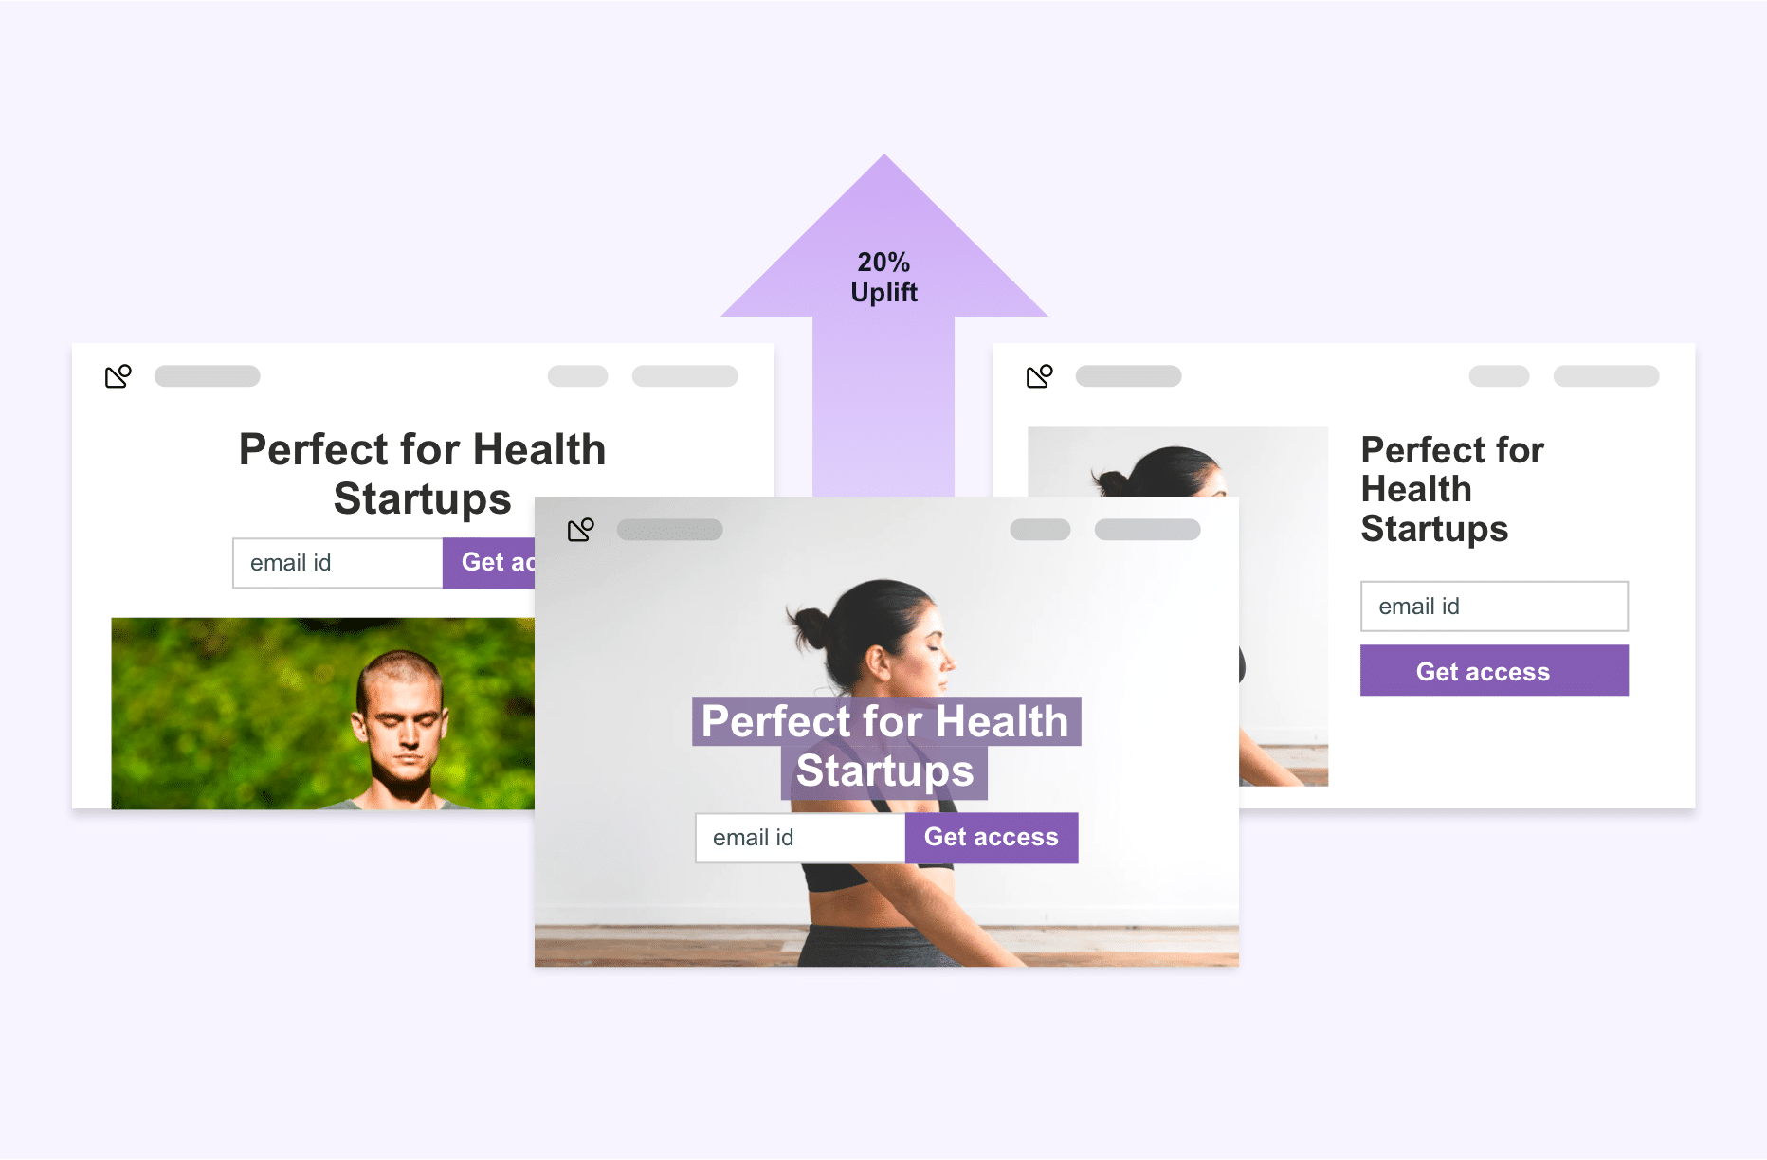
Multipage testing
A/B testing
Multipage testing is a form of experimentation where you can test changes to elements across multiple pages.
It enables you to create consistent experiences for your target audience.
It helps your target audience see a consistent set of pages, no matter if it’s the control or one of its variations.
https://vwo.com/ab-testing/#different-types-of-a-b-tests
Notes:
Multipage :Multipage testing is a form of experimentation where you can test changes to elements across multiple pages.
There are two ways to conduct a multipage test. One, you can either take all the pages of your sales funnel and create new versions of each, which makes you challenge the sales funnel, and you then test it against the control. This is called Funnel Multipage testing.
Two, you can test how the addition or removal of the recurring element(s), such as security badges, testimonials, etc., can impact conversions across an entire funnel. This is called Classic or Conventional Multipage testing.
Advantages of Multipage testing
Like A/B testing, Multipage testing is easy to create and run and provides meaningful and reliable data with ease and in the shortest possible time.
It enables you to create consistent experiences for your target audience.
It helps your target audience see a consistent set of pages, no matter if it’s the control or one of its variations.
It enables you to implement the same change on several pages to ensure that your website visitors don’t get distracted and bounce off between different variations and designs when navigating through your website.

Slide 14
When to do A/B testing: Stop guessing, start testing!
A/B testing
#1
#2
#3
Do A/B testing when the design team aims to improve user experience or engagement
Do A/B testing when you redesign your website.
Do A/B testing when you change a service, plugin or feature.
#4
#5
#6
Do A/B testing when you change prices.
Do A/B testing when you think your conversion rates need optimization.
Do A/B testing when you want to raise revenue.
https://www.crazyegg.com/blog/when-must-test/
Notes:
A/B testing can measure the actual behaviour of your and helps you confidently conclude if version B has better conversion rates than A.
It can measure very small performance differences with high statistical significance
Resolve trade-offs between conflicting guidelines or qualitative usability findings by determining which one carries the most weigh.

Slide 15
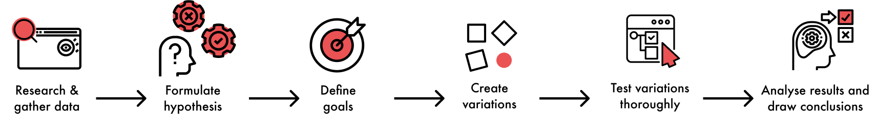
A/B testing process
A/B testing
Notes:
Though A/B testing process is not always a happy path but with time, many teams have streamlined it in order to make the most of it. The process that you see on the screen is ideally for when a team wants to A/B test after the launch of a product/ service.
Having said that, A/B testing can also be done during the wireframe or planning stage and could be combined with Guerilla testing.
A/B testing in the early stages of product development helps in combatting any conflicts between design/product teams and business to help shift focus on user-centered goals.

Slide 16
How do we do A/B testing – Checklist
A/B testing
Pre-testing
During testing
Post-testing
Get the testing tool
Pick variable to test
Define primary success metric
Define idea/question to be tested
Split your sample groups equally and randomly
Test both variations simultaneously
Give the A/B test enough time to produce useful data
Focus on your goal metric
Measure the significance of your results
Document all the findings
Plan your next A/B test (if required)
Notes:
Pre AB testing – what we need to do before starting the AB test
During AB testing – what we need to do while performing the AB test
Post AB testing – What we need to do when AB test is completed

Slide 17
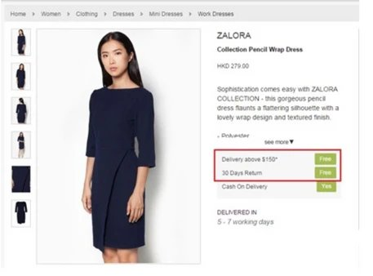
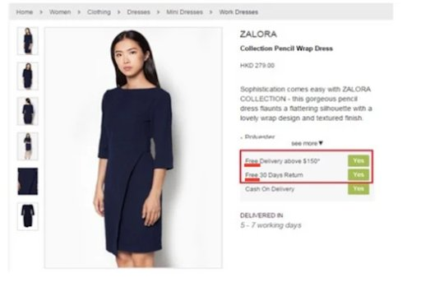
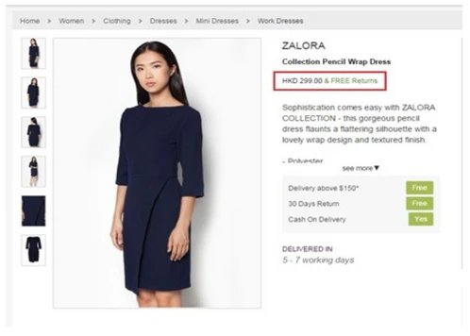
Zalora’s checkout rate up by 12.3%! Thanks to optimizing one CTA
A/B testing – Case Study 1
CONTROL
VARIATION 01
VARIATION 02
Defect
Customers were unaware of Zalora’s free return policy due to poor visibility.
Action
Variation 1 Shift the “Free” keyword from the right to the left-most position
Variation 2 Add “& Free Returns” copy next to the price tag
Test Results
Zalora found that Variation 1 outperformed the control and its counter variation 2 by simply bringing uniformity in the call-to-action button.
https://vwo.com/blog/ab-testing-examples/
Notes:
Zalora is one of the fastest growing online fashion retailers in the Asia-Pacific region. The eCommerce store is most known for its chic and snazzy fashion and beauty products. Zalora is one of VWO’s esteemed customers and has been using its services day-in-day-out.
Of the many successful A/B tests that Zalora has run so far, one experiment that really stood out was optimizing the design of product pages to highlight some of the brand’s rewarding features like free return policy and free delivery services.
The eCommerce company produced this hypothesis basis the data collected by its customer service team. It contended that customers were unaware of Zalora’s free return policy due to poor visibility of the feature on the product pages. The team soon made necessary amendments and ran an experiment to note customer reactions.

Slide 18
4 possible outcomes from A/B testing
A/B testing
In most cases, it is not just as simple win or loss.
The best thing to do once we have the test results is to deep dive into metrics and accentuate any use cases that help the business in any way.
#1
#2
False positive (you detect a winner when there are none)
False negative (you don’t detect a winner when there is one)
#3
#4
No difference between A & B (inconclusive)
Win (either A or B converts more)
Notes:
1. A false positive is where you receive a positive result for a test, when you should have received negative results. It’s sometimes called a “false alarm” or “false positive error.” In statistics, a false positive is usually called a Type I error.
For example: Someone’s Covid test is positive, Whereas in reality they do not have Covid.
2. A related concept is a false negative, where you receive a negative result when you should have received a positive one.
For example, a pregnancy test may come back negative even though you are in fact pregnant.
Always check test results to see the following metrics and make deeper meaning: by source (where did they come from), by behavior (what do they want on your website), by outcome (what do they want from your website).

Slide 19
Pitfalls to avoid during A/B testing
A/B testing
#1
#2
#3
Not enough sample size OR
testing too many variables at once
Ignoring statistical significance and failing to consider external factors
Not clustering heavy & light users in equal proportions​
#4
#5
#6
Focusing predominantly on the short term or ending the test prematurely​ if it fails the first time
Don't A/B test if there is no informed hypothesis​ and using metrics that do not reflect business objectives
Not optimizing by iterating consistently on past learnings
BONUS: Don’t overlook mobile.
Notes:
While most design and product teams A/B test their prototypes, often they tend to find themselves stuck in loopholes that could easily be avoided. Successful A/B testing has multiple steps - from creating a process and understanding how to formulate a hypothesis to setting up your A/B tests and then knowing when to end them. While all of these are vital, making sure you’re correctly interpreting your results is just as important.
Testing too many variables to run the A/B test leads to confusion and might even lead to cascade testing which is frowned upon as it gives an inconsistent result.
Imagine an e-commerce organisation comparing their regular day sales wrt to something like a Black Friday or Big Billion Day – external factors need to be accounted for and one should respect statistical significance.
Customer segmentation is key in order to have a fair outcome. Randomisation may be lethal at times.
Believing in metrics, focusing on planned test goals and timing it sufficiently is key.
Always work towards business or user goals and build hypothesis around them in order to make the most impact.
Learning from past experiments and research goes a long way.
Always check test results to see the following metrics and make deeper meaning: by source (where did they come from), by behavior (what do they want on your website), by outcome (what do they want from your website).

Slide 20
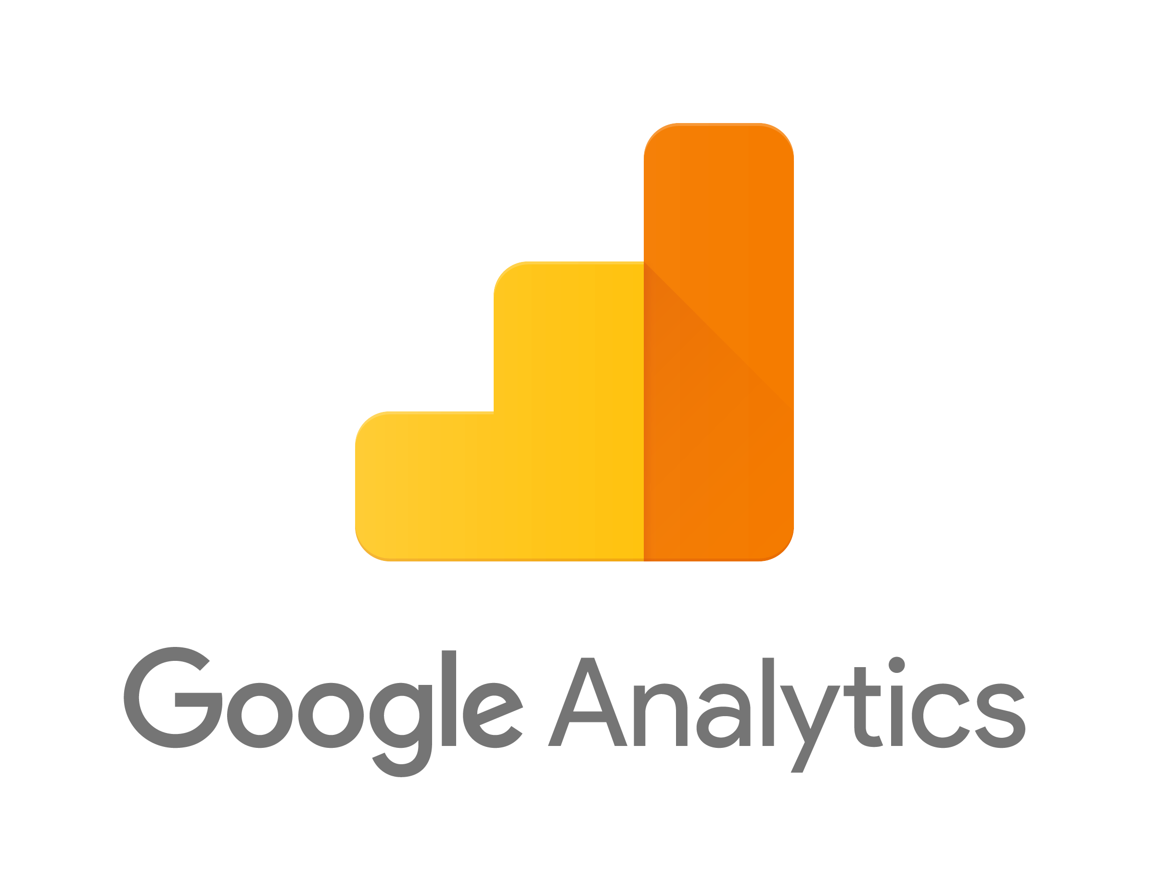





Tools & applications
A/B testing
Product Changes - Web, Desktop, Mobile
Landing Page Optimization
Creative design
Funnel conversions
Conversion Rate Optimization (CRO)
User testing

Slide 21


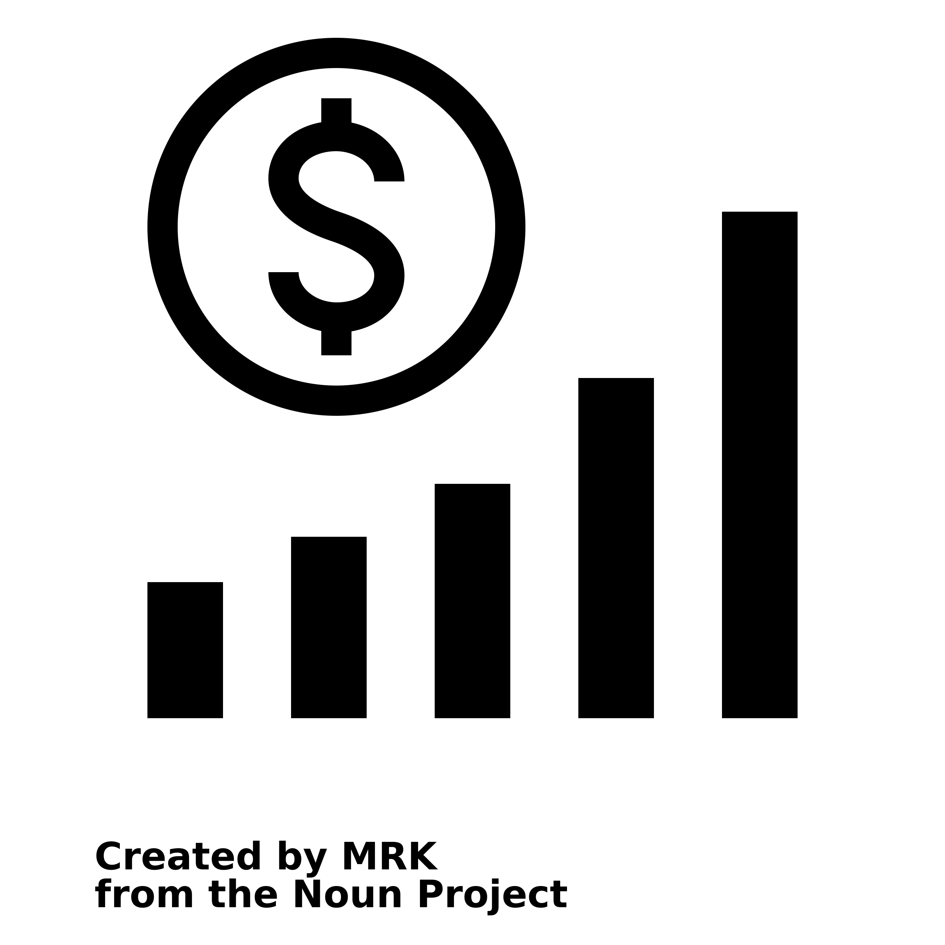


Quick recap on why you should consider A/B testing
A/B testing
Increase user engagement
Reduce bounce rates
Increase revenue & conversion
Learn what works
Quick results

Slide 22
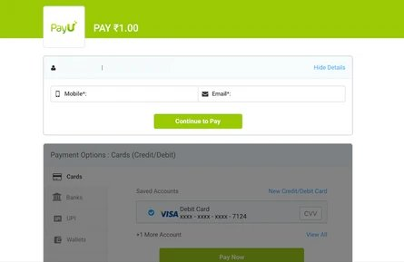
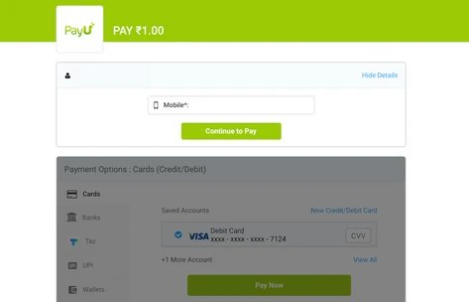
PayU increased its conversions by 5.8% using data-driven A/B testing
A/B testing – Case Study 2
CONTROL
VARIATION
Defect
PayU’s Checkout page statistics showed performance issues.
Action
PayU existing Checkout page asked users their mobile number and email address. The new one only asked for mobile number.
Test Results
The company was able to register an improvement of 5.8% in conversions as compared to the control.
Notes:
PayU is an Indian-origin fin-tech company that provides an exclusive range of financial solutions for local and cross border merchants in emerging markets. As a payment facilitator, PayU finds it important to maintain a simple, intuitive, and convenient checkout process and eliminate all plausible elements which may cause drop-offs.
What is a control? Control is the current version against which the impact of each variant is measured.
Defect: The company, by using VWO Form Analytics capabilities, found that a lot of people were dropping off from the page, which was significantly impacting their sales and revenue graph.
Action: PayU decided to make minor changes on its Checkout page form basis the data gathered and run an A/B test to validate their hypothesis. While the old PayU Checkout page asked users to enter their mobile number and email address to complete the purchase process, the new Checkout page, on the other hand, only asked for a user’s mobile number.
Test Results: The test results showed that by simply eliminating the email address field from the form placed on their Checkout page, the company was able to register an improvement of 5.8% in conversions as compared to the control.
---------------------------------------------------------------------------------------------------------------------
Before we move on, we’d also want to touch upon the $300 mil button. For all of those who are not familiar with it, have you ever heard a small design decision impacting the annual revenue of a website by $300 million? It’s hard to imagine a form that could be simpler: two fields, two buttons, and one link. Yet, it turns out this form was preventing customers from purchasing products from a major e-commerce site, to the tune of $300,000,000 a year. What was even worse: the designers of the site had no clue there was even a problem.
The form was simple. The fields were Email Address and Password. The buttons were Login and Register. The link was Forgot Password. It was the login form for the site. It’s a form users encounter all the time. How could they have problems with it?
The problem wasn’t as much about the form’s layout as it was where the form lived. Users would encounter it after they filled their shopping cart with products they wanted to purchase and pressed the Checkout button. It came before they could actually enter the information to pay for the product.
The team saw the form as enabling repeat customers to purchase faster. First-time purchasers wouldn’t mind the extra effort of registering because, after all, they will come back for more and they’ll appreciate the expediency in subsequent purchases. Everybody wins, right?
The designers fixed the problem simply. They took away the Register button. In its place, they put a Continue button with a simple message: “You do not need to create an account to make purchases on our site. Simply click Continue to proceed to checkout. To make your future purchases even faster, you can create an account during checkout.”
The results: The number of customers purchasing went up by 45%. The extra purchases resulted in an extra $15 million the first month. For the first year, the site saw an additional $300,000,000.
https://vwo.com/blog/ab-testing-examples/

Slide 23
References
A/B testing
Sample size calculator: https://experienceleague.adobe.com/tools/calculator/testcalculator.html

Slide 24
Hope this session was useful for you to understand A/B test as a UX process.
A/B testing

